Slide 1
MIS Midcorp project
November 2020

Slide 2
Agenda
01. Project background and objectives
02. Data Scope for integration
03. Target process alignment
04. Technical integration

Slide 3
01
Project background and objectives

Slide 4
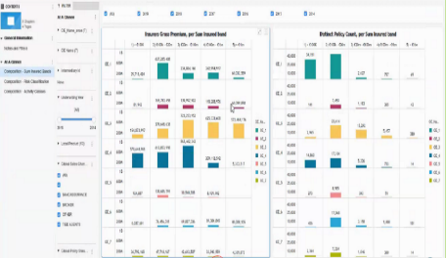
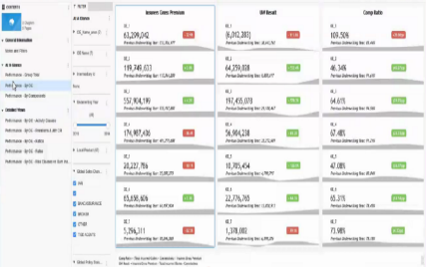
MIS Midcorp solution provides all relevant midcorp data for better business steering
Simplified overview of target solution
Objectives for the MidCorp business
Source data (examples)
MidCorp MIS dashboards
Improved transparency on performance
Underwriting WB / ITMP
OE data source systems
Global Data Platform
Radar live
Financial data
Consistent, comparable data across the MidCorp segment
Nat Cat
LCE 360
„Group-wide utility“ for OEs to use for portfolio analytics
Prioritized data integration
Other data integration in scope

Slide 5
Business objectives for integration of financial data in MIS MidCorp solution
01
02
03
Create Micro Strategy financial dashboards for MidCorp business and make them available to MidCorp representatives for portfolio steering purposes
Automate most of the manual steps in the quarterly reporting
Combine all the necessary reporting data flow into a single platform to ultimately enable some form of bridge of operational and financial data in a dashboard

Slide 6
objectives and requirements of first financial data integration into MIS MidCorp
Details on next presentation chapter
Requirements for integration of financial data
Activities and developments so far
MIS STC To Dos & guidance
H2 requirements
MIS should not be considered as primary financial source
Reports should be pre-configured together with H2
Design a governance process that ensures that financial information is correct and signed off in the MIS tool
Consider usage of SAP analytics cloud
Similar to as-is situation. Is not supposed to be changed
Bridging of operational and financial data is a key expectation from the business
Visualization of financial data in MIS MidCorp to be restricted to CUOs and above
Integration in the Global Data Platform to be further investigated
First assessment of data required and dashboard output developed in alignment with H2
2
Initial proposal defined for joint process governance with H2 for integration of financial data
3
SAP analytics cloud considered, and demo conducted
Initial scenarios developed and discussed in MIS MidCorp Steering committee
4

Slide 7
02
Data scope for integration

Slide 8
Financial data integration in MIS MidCorp are exclusively from the Solvency 2 database
But
Unaltered information
No additional adjustments
No separate forecasting/projections
Potentially additional granularity over time

Slide 9
03
Target Process alignment

Slide 10
Annual process for plan data
Beginning Q3 (?)
November
End Q4 (?)
First version of the planned numbers uploaded by OEs prior the PD into the Solvency II LoB Reporting in SAP (coordinated by GAPC)
OE uploads the final planned data into the Solvency II LoB Reporting in SAP (coordinated by GAPC)
OE
1
5
MIS Midcorp Business Workstream (AZ Re)
Quality check by AZ Re: Mid Corp flag is defined per portfolio
Manual quantifying the final Core Midcorp plan by extracting MC Core portfolios based on distribution channel
Data transferred to the reporting layer of the micro strategy
3
8
9
MIS MidCorp Technical Workstream (H4/AZ Tech)
H2 transfers data to GDP
7
H2 (GAPC & GAR)
High level check by H2 (whether the uploaded sum of portfolios across P&C match the overall OE plan on all P&L positions)
MC flag is included in the OE data the SAP system
High level check by H2 (whether the uploaded sum of portfolios across P&C match the overall OE plan on all P&L positions)
2
4
6
Global P&C
Ongoing discussion with OEs identifying the plan data
Automated step
Manual step

Slide 11
process for actual data per reporting cycle
End of Q1
???
OE uploads the actual data for Q1into the Solvency II LoB Reporting in SAP (coordinated by GAPC)
Manual inquiry to the OEs from AZ Re for the forecast data
OE
1
6
MIS Midcorp Business Workstream (AZ Re)
Quality check on the MidCorp flag by AZ Re (e.g. check if portfolios in scope have not been slightly renamed
Manual quantifying the final Core Midcorp plan by extracting MC Core portfolios based on distribution channel
Data added to the reporting layer
Micro strategy Dashboard created
3
5
7
8
MIS MidCorp Technical Workstream (H4/AZ Tech)
H2 transfers data to GDP
4
H2 (GAPC & GAR)
High level check by H2 (whether the uploaded sum of portfolios across P&C match the overall OE plan on all P&L positions)
2
Global P&C
Automated step
Manual step

Slide 12
04
Technical integration

Slide 13


Global Data platform is providing all required functionalities for MIS
MIS MidCorp target architecture (simplified view)
Data Governance
End User Consumption
GDP Provisioning Layer
Glossary
Catalog/ Dictionary
Virtualization for consumption – Nov 2020
GDP Data Layer (only relevant zones shown)
Business terms to Technical
Mapping
Schema to Schema Mappings
Consumption
Reference Data Management Tool
Reads
MidCorp Harmonized model
Ingestion service
IDQ (transformation rule engine) – Nov 2020
Source connector
Data Stream
Sink Connector
Raw
1:1 with Source
Archive
Long Term Storage
Automatic ingestion (with Pilot OEs)

Slide 14
Initial assessment of Scenarios for integration of financial data
Based on assessment conducted with AZ technology. Alignment with H2 pending
1
2
Excel extract & upload on GDP
Technical integration with GDP
User access to financial information
Automation of process
Bridge operational & financial data
File manually extracted and uploaded in GDP
Several steps of the process can be configured on the GDP for better traceability
SAP licenses required for each MIS MidCorp user
Establish integration between SAP and GDP
Several steps of the process can be configured on the GDP for better traceability
SAP licenses required:
Single user approach: ~200€ per user p.a.
Integration approach (1 license for integration with the GDP): ~200k€ + 35k€ p.a.
Details for integration to be analyzed
* Feasibility to be further analyzed
Possible / enabled
Partially possible / enabled
Not possible / enabled

Slide 15
BACK-UP

